Slide 1
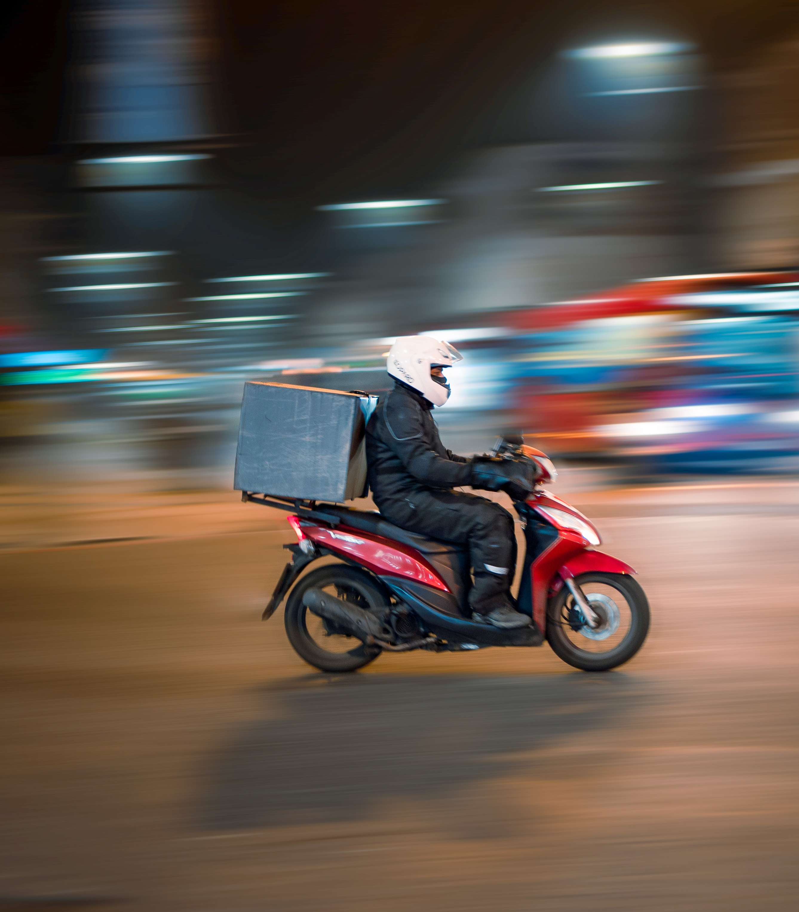
DishDrop – Food Ordering/Delivery Management System
Group 15 Chinmay Dharwad. 002771031
Kishor Channal. 002737089
Manoj Chandrasekaran. 002767647
Nagarjun Mallesh. 002788601
Sanjay Bhaskar Kashyap. 002780659

Slide 2
Problem Statement and Goals
Problem statement
Problem Statement
The current food ordering and delivery process is inefficient, leading to customer dissatisfaction and decreased productivity.
The existing system lacks a comprehensive and accurate database management system to track customer orders, menu items, inventory, and delivery information.
A Food Ordering/Delivery Management System is needed to improve the overall efficiency and accuracy of the food ordering and delivery process by collecting, maintaining, and providing real-time access to transactional and reference data.
Goals
Improve the food ordering and delivery process to enhance customer satisfaction and increase productivity for delivery services by reducing inefficiencies and inaccuracies.
Implement a comprehensive and accurate database management system to effectively track customer orders, menu items, inventory, and delivery information.
Improve inventory management by implementing real-time data analytics and information.
Establish effective tracking and management of transactional and reference data related to customer orders, menus, inventory, and deliveries.

Slide 3
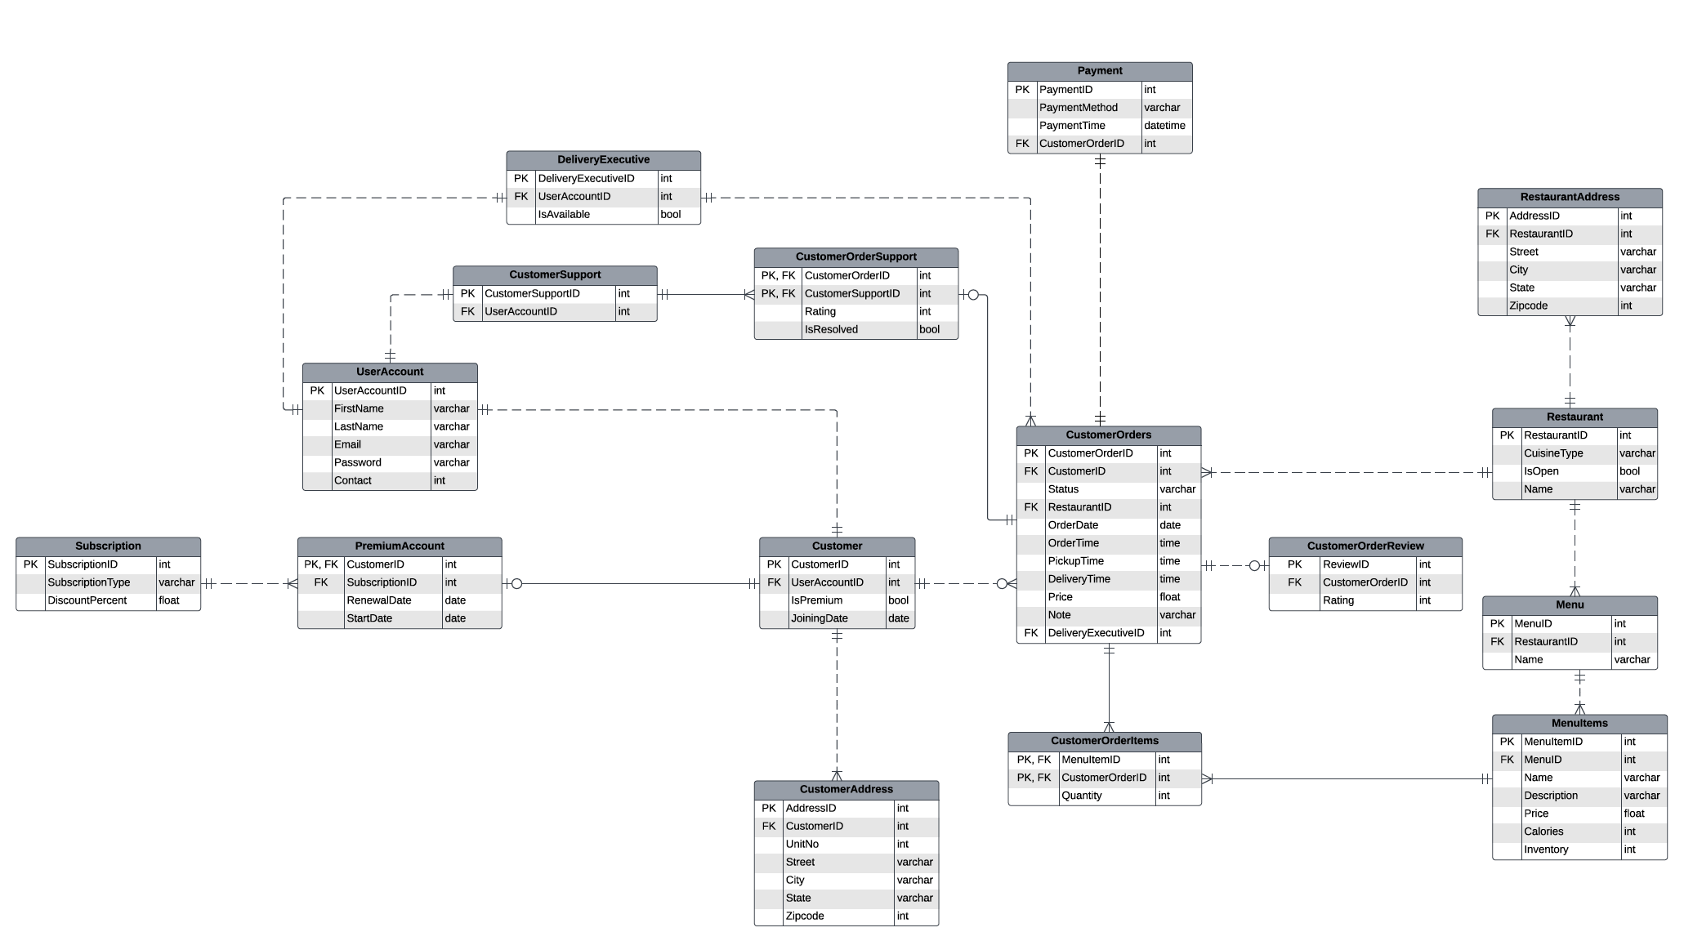
Entity Relationship Diagram
Entity Relationship Diagram

Slide 4
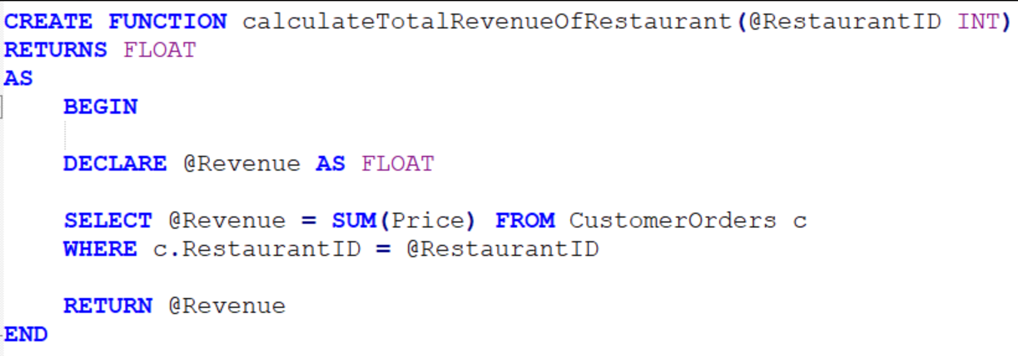
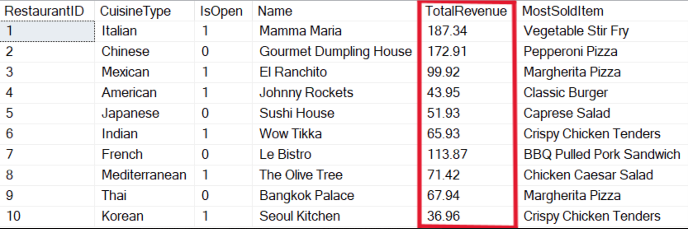
Function 1: Calculate Total Revenue of a Restaurant
Compute Column based on Function

Slide 5
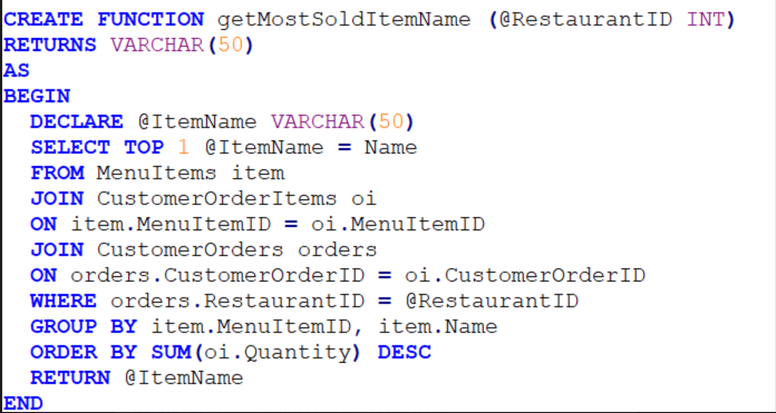
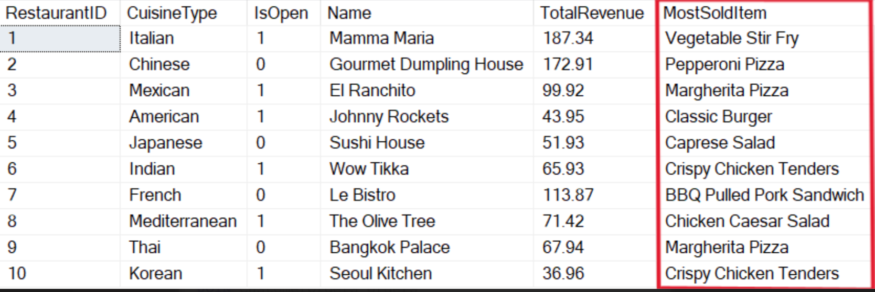
Function 2: Calculate Most Sold Item of a Restaurant
Compute Column based on Function

Slide 6
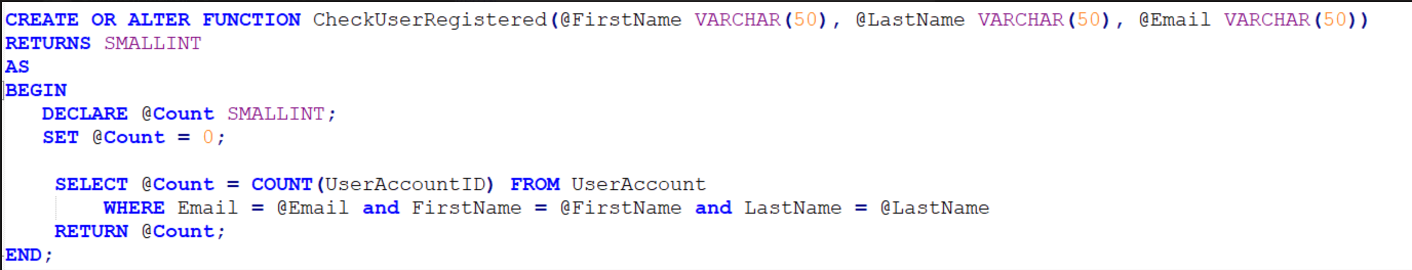
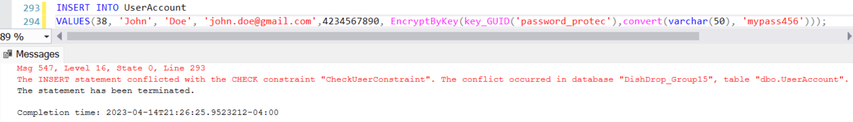
Constraint to not allow a User with the same name and email to register
Table Level CHECK Constraint based on a function

Slide 7
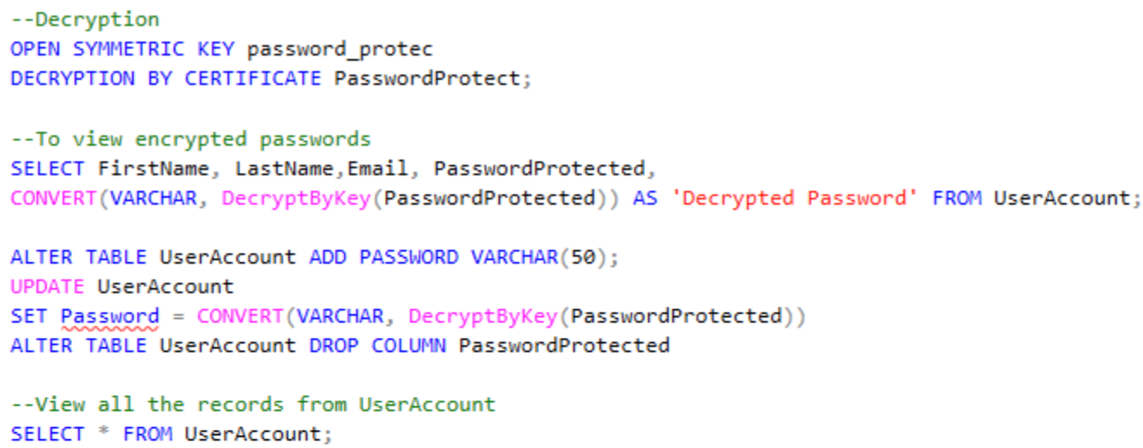
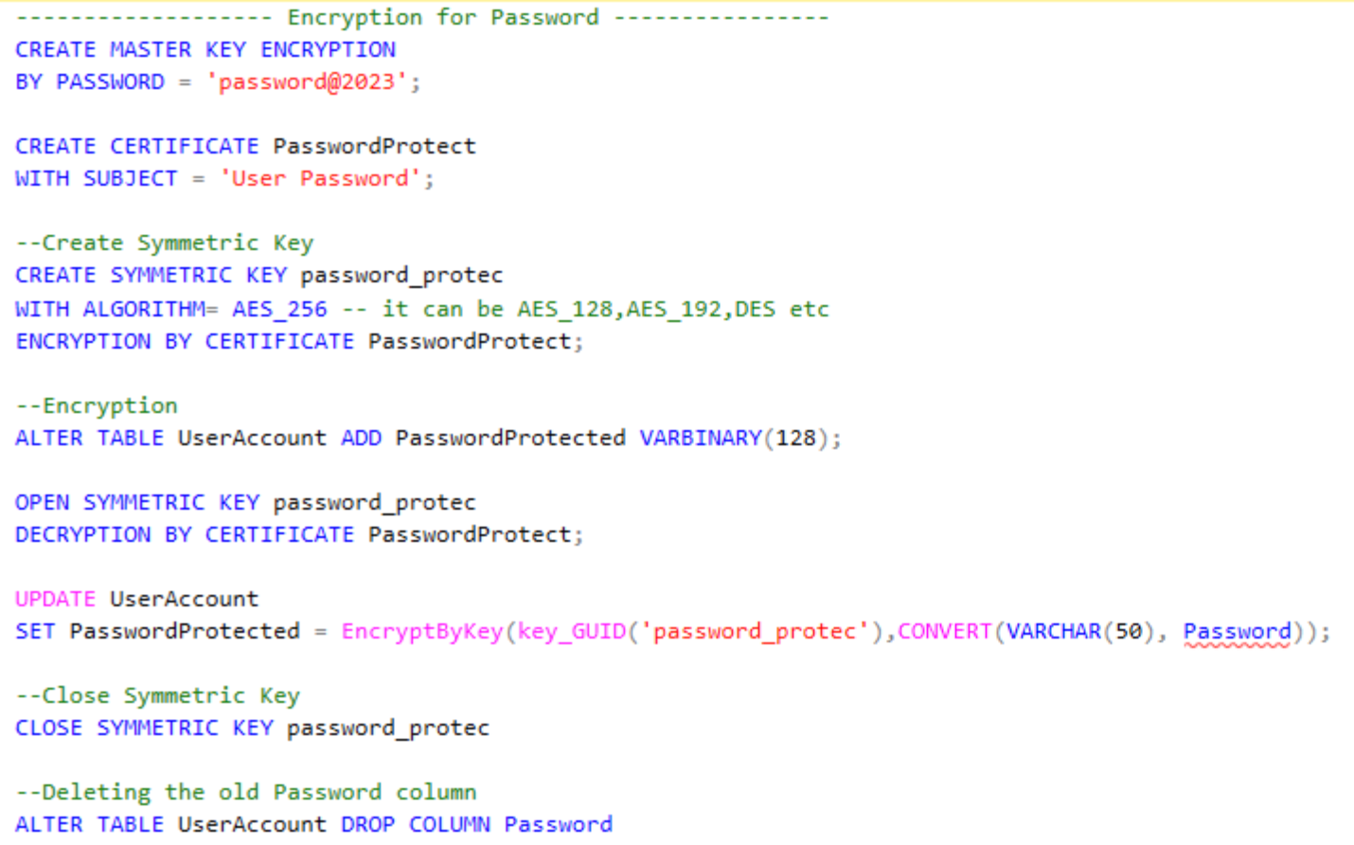
Column Data Encryption
Encryption and Decryption
Encryption
Decryption

Slide 8
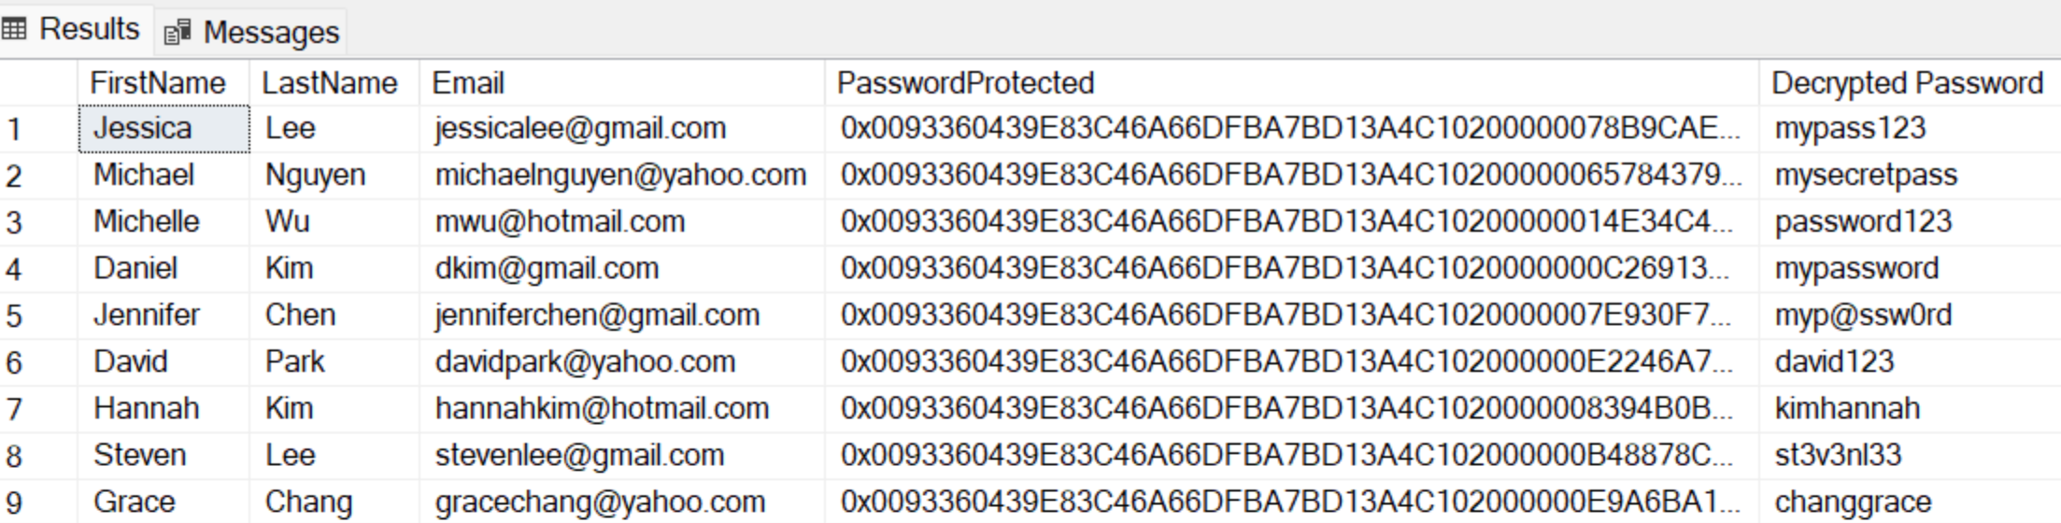
Encryption and Decryption Output
Encryption and Decryption

Slide 9
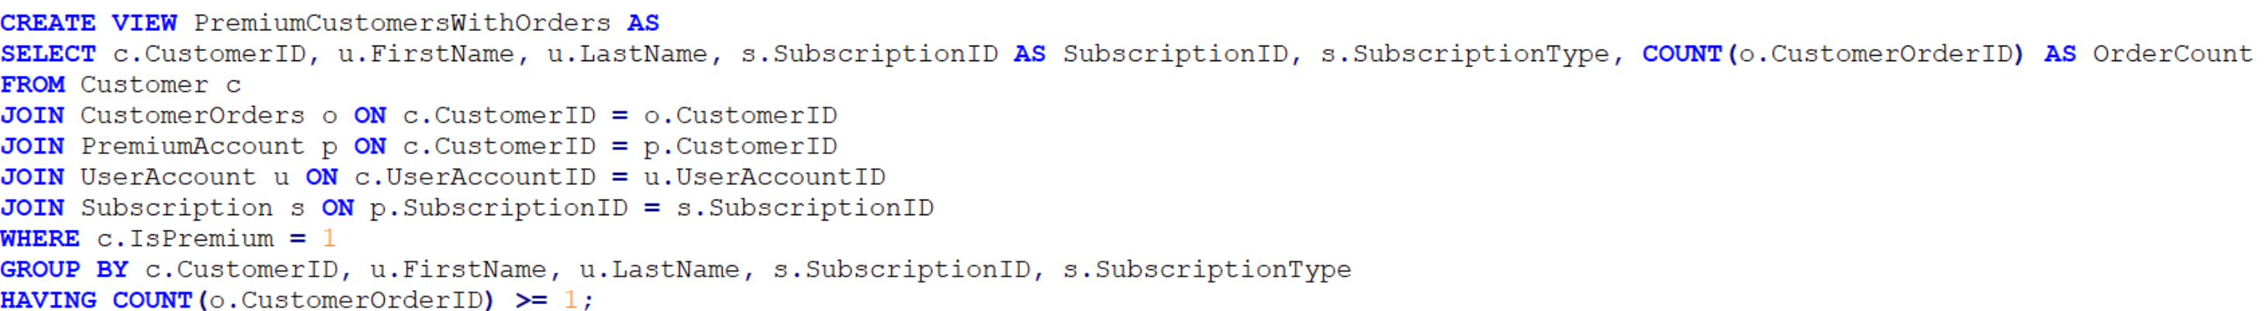
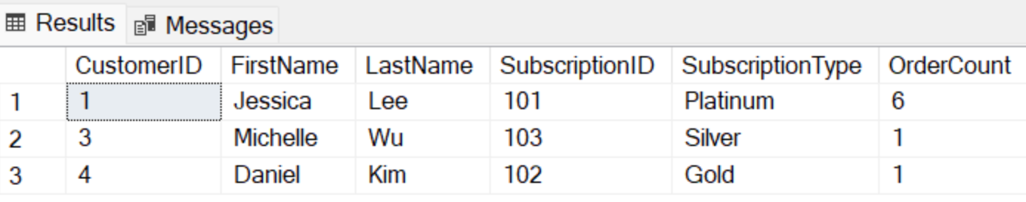
View 1: Display Customers with Premium Account who have placed at least one order
Views

Slide 10
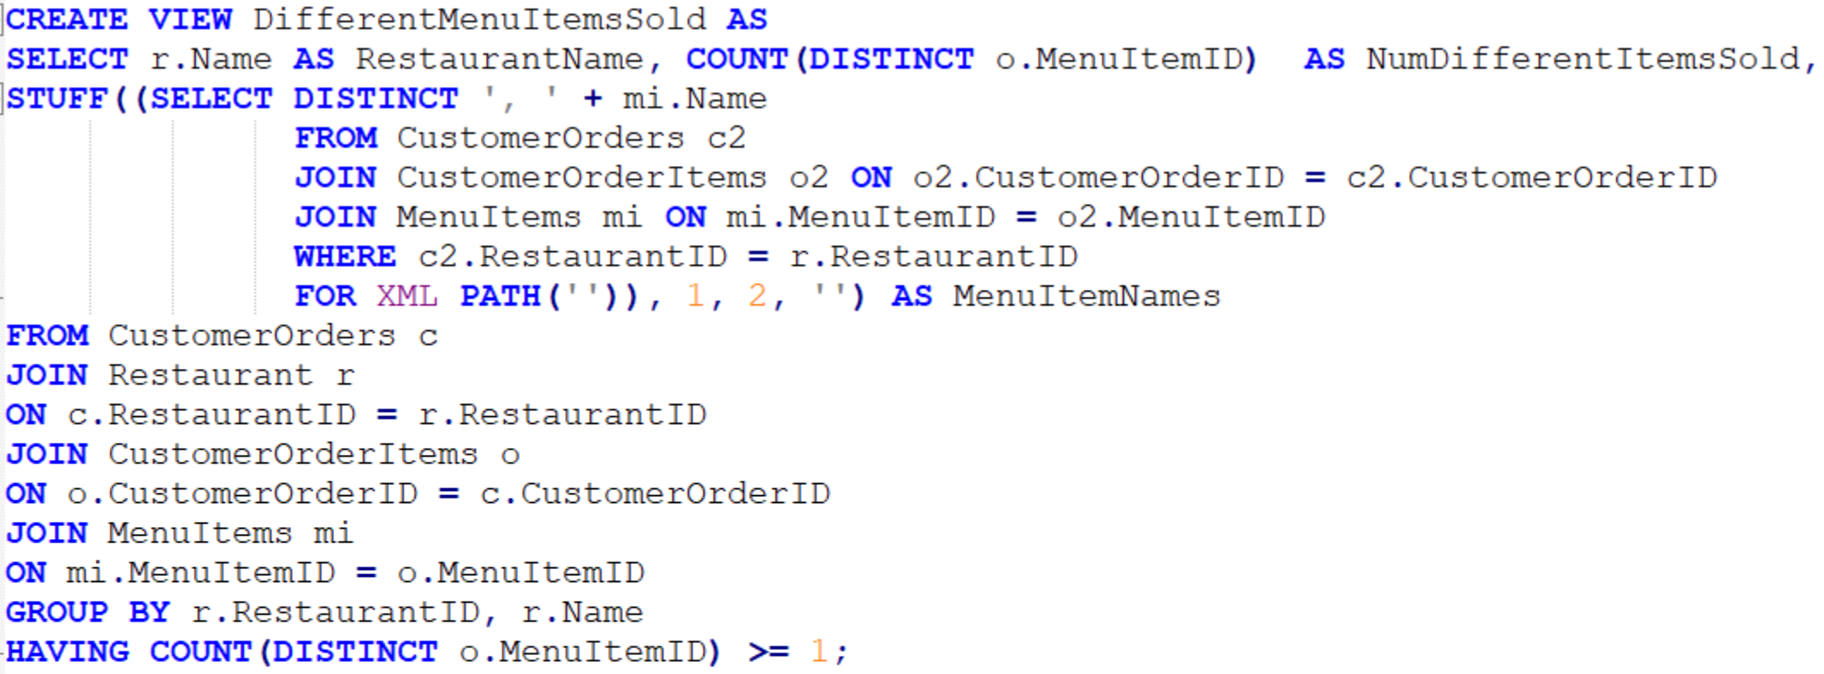
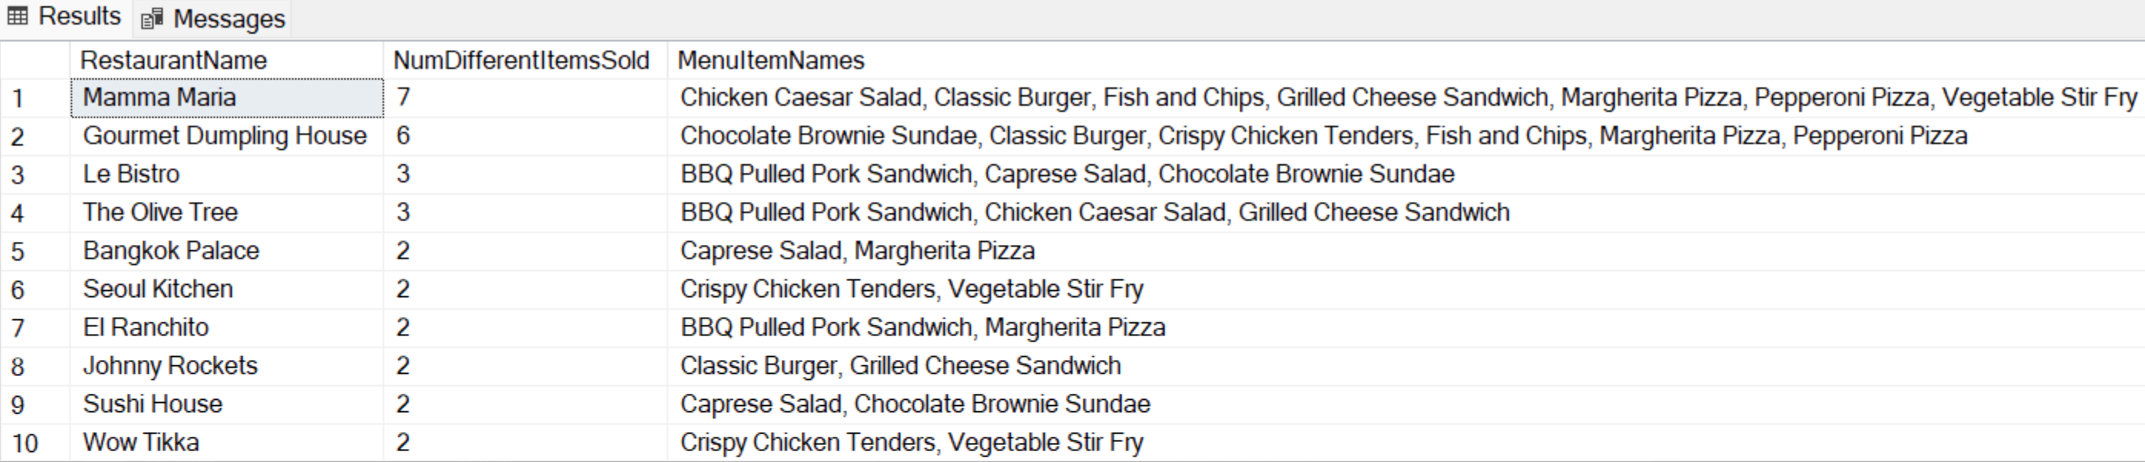
View 2: Display the Restaurant which has sold most number of unique Menu Items in descending order
Views

Slide 11
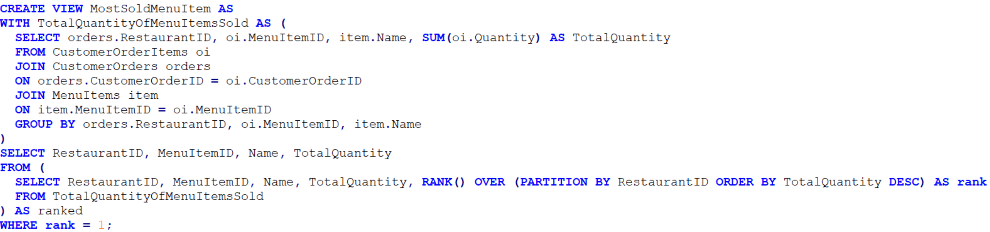
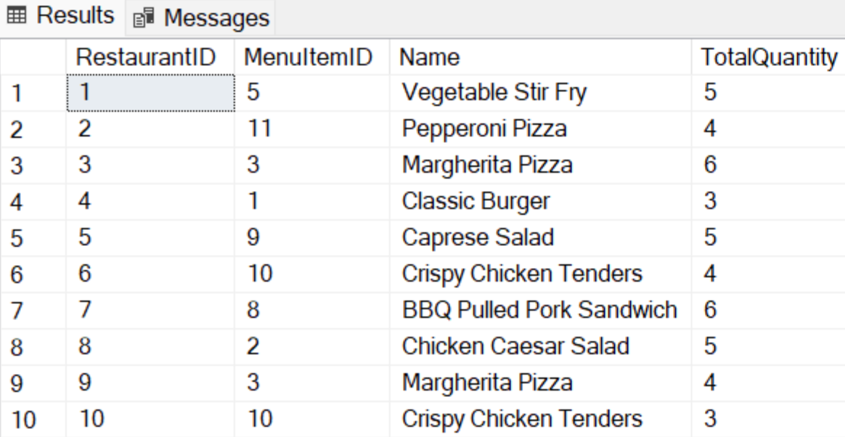
View 3: Display the most sold Menu Item in each Restaurant
Views

Slide 12
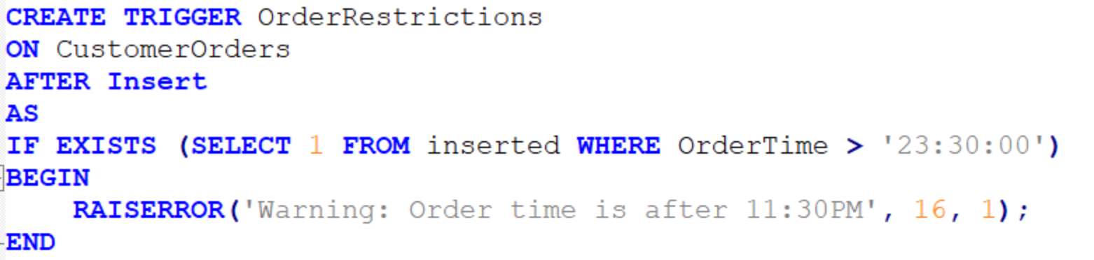
Trigger 1: To check if the OrderTime does not exceed 23:30:00
Triggers

Slide 13
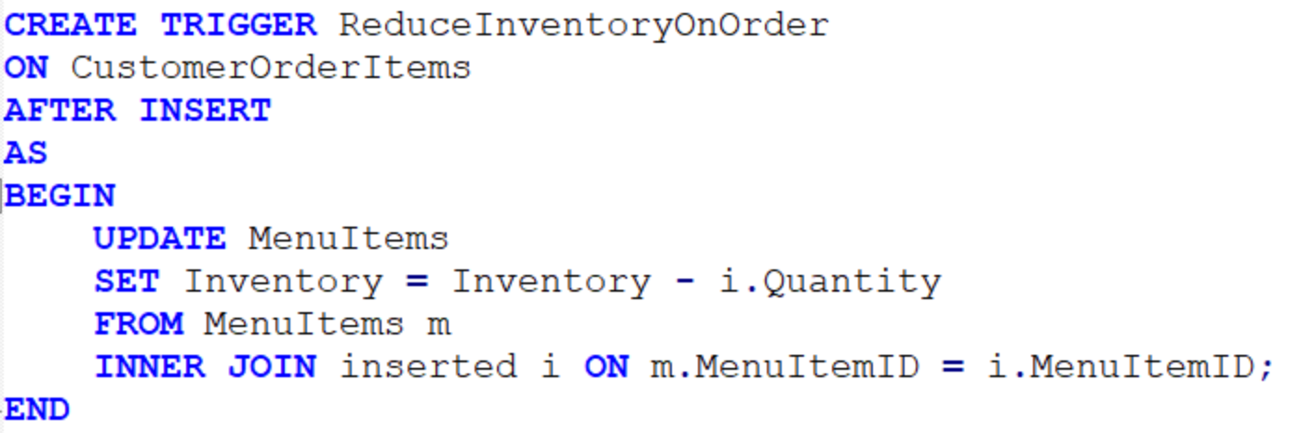
Trigger 2: To regulate the inventory based on the Customer Orders
Triggers

Slide 14
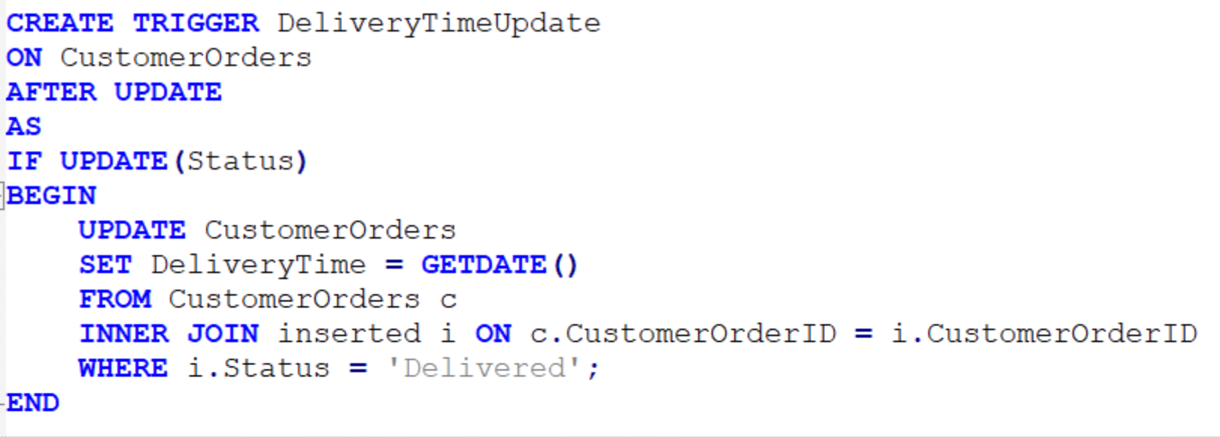
Trigger 3: To Update the Delivery Time after Order is delivered
Triggers

Slide 15
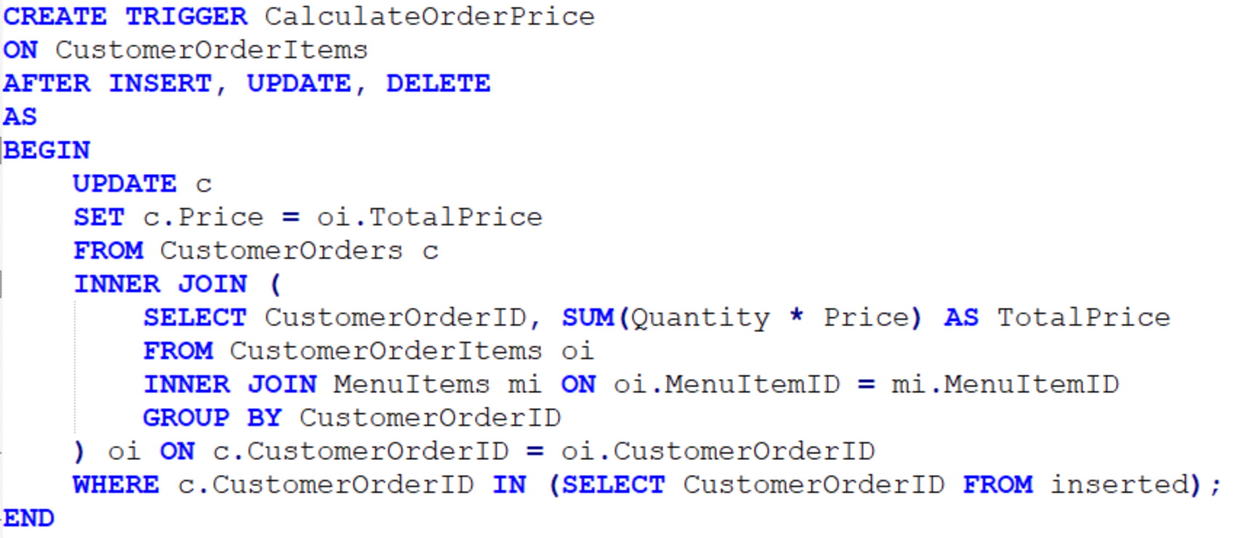
Trigger 4: To Update the OrderPrice based on quantity and unit price
Triggers

Slide 16
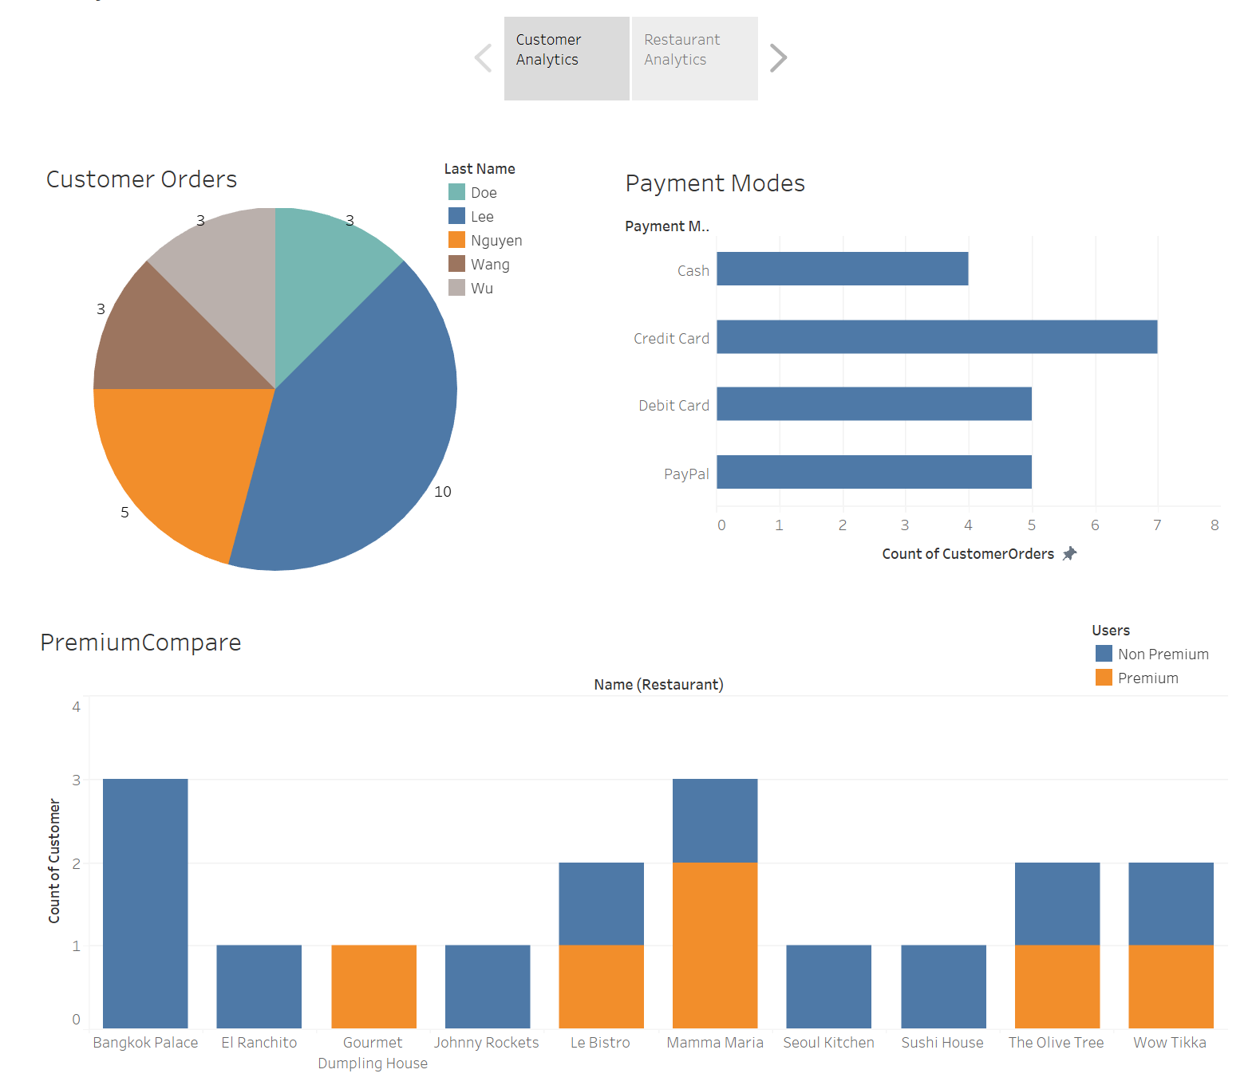
Visualization – Customer Based Analytics
Visualizations

Slide 17
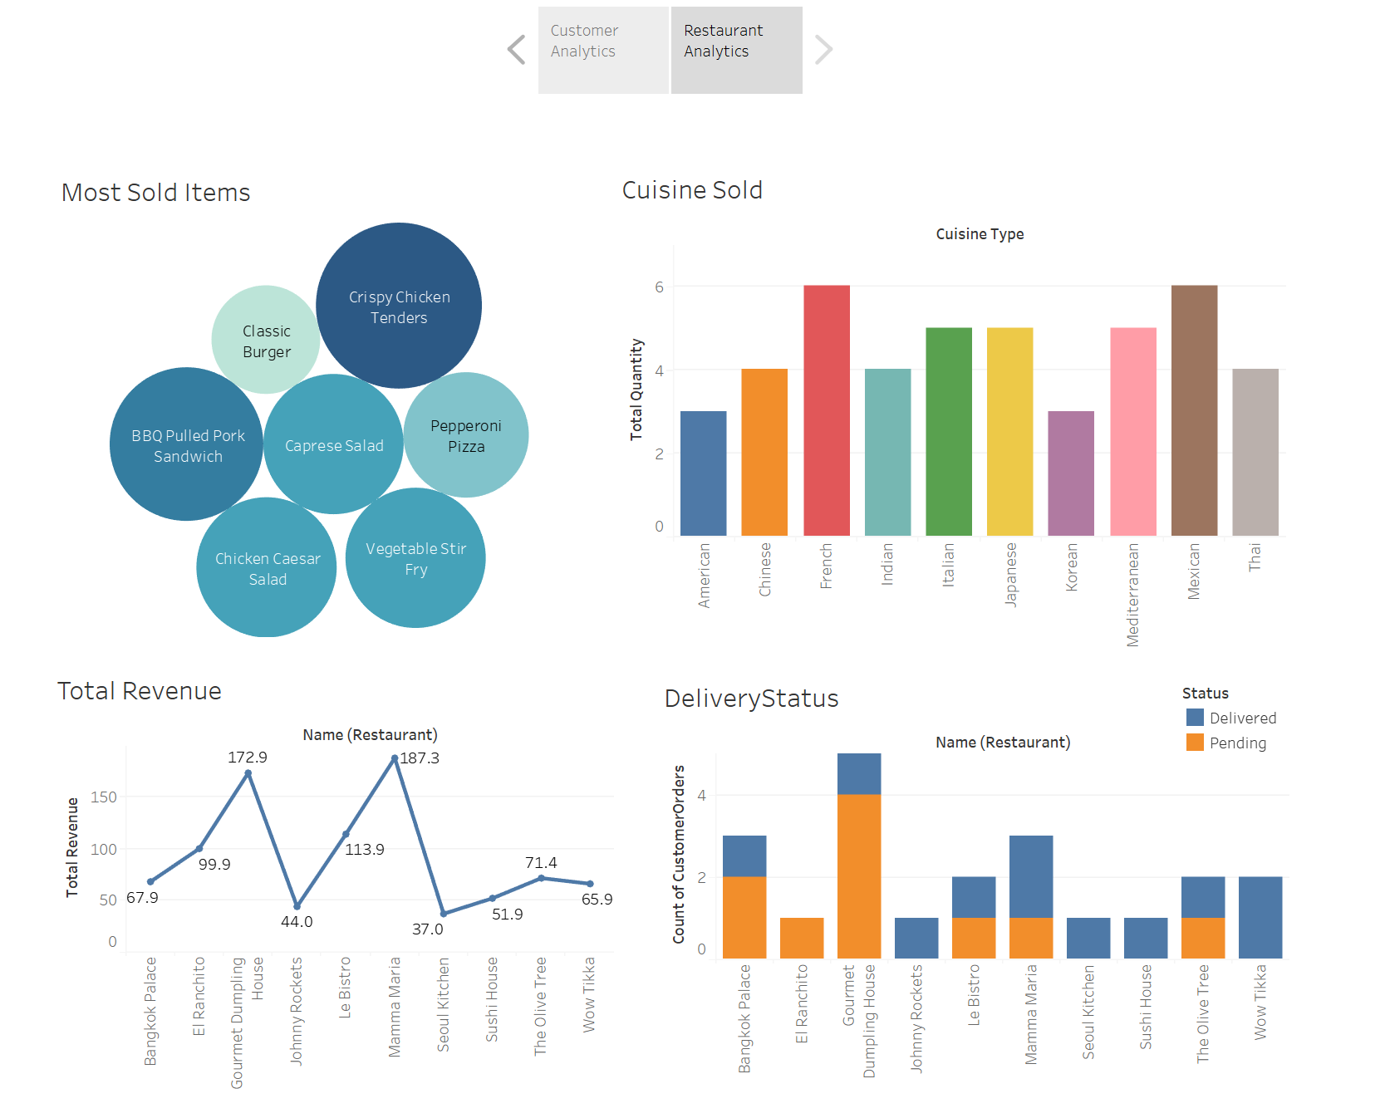
Visualization – Restaurant Based Analytics
Visualizations

Slide 18
Thank you!
Happy Eating

